Slide 1

TechCore Innovation- HR
Date Range

Slide 2
TechCore Innovation- HR
Date Range
Resignation Overview
Resignation by Reason
Resignation by Gender
Resignation by Type
Resignation by
Resignation by

Slide 3
TechCore Innovation- HR
Date Range
Department
Resignation Overview
Gender-Based Resignation Trends
Resignation by Organizational Level and Gender
Resignation (Current Year vs Previous Year)
Resignation vs Hires
Time to Quit by Age Band
Time to Quit ( Years)
Time to Quit by Location

Slide 4
TechCore Innovation- HR
Year
Month
Department
Attrition Rate Overview
Attrition Rate by
Attrition Rate by
Voluntary Attrition by Gender
Overall and Voluntary Attrition Rate

Slide 5
TechCore Innovation- HR
Employee ID
Prediction Result
Likelihood of Resignation and Risk Probability
Prediction Accuracy

Slide 6
TechCore Innovation- HR
Date Range
Voluntary Attrition by Job Title
Voluntary Attrition Rate

Slide 7
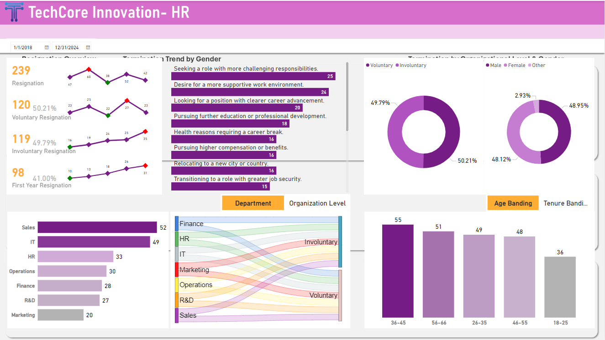

Slide 8
TechCore Innovation- HR
Performance Review Years
Employee ID
Full Name

Slide 9
TechCore Innovation- HR
Performance Review Years
% Distinct ID by Organization Level & Performance Rating
% Distinct ID by Gender & Performance Rating
Distinct ID (Year)
Distinct Count of ID by Age Category & Performance Rating
Distinct Count of ID by Department & Performance Rating

Slide 10
TechCore Innovation- HR
Performance Review Year
Department
Month Name

